Slide 1
Abstractive Text Summarization
TEAM MEMBERS :
TARUN R - 1MS17IS123
SUMUKH M LOHIT - 1MS17IS120
D SAI VISWA SUMANTH - 1MS17IS154
NIKHIL THADESHWAR - 1MS17IS076

Slide 2
Applications of Text Summarization

Slide 3
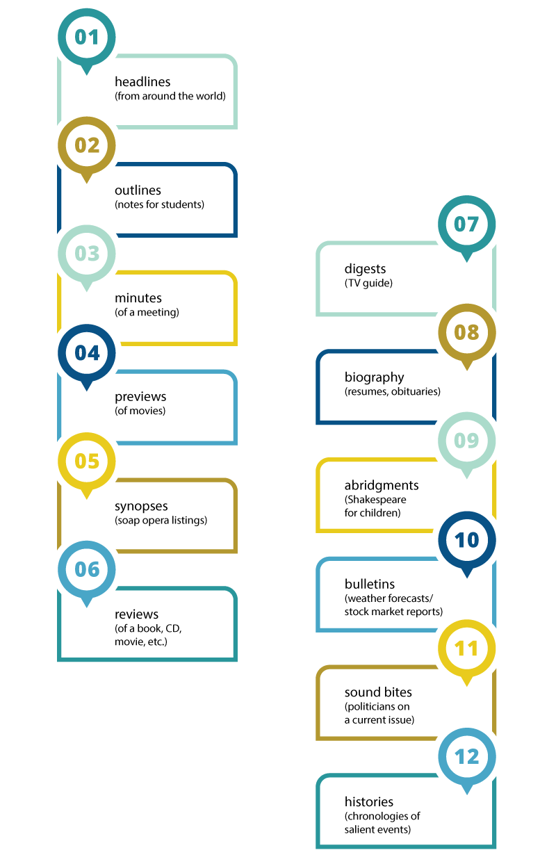

Slide 4
Basics of Abstractive text summarization

Slide 5
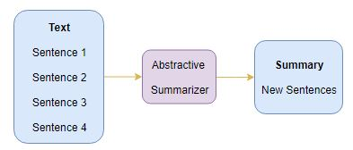
Technique of generating a summary of a text from its main ideas, not by copying verbatim most salient sentences from text.
Generates new sentences
Generates grammatically correct sentences
It has the ability to tell the important information from text documents.

Slide 6
Abstractive vs Extractive Text Summarization

Slide 7
Extractive Summaries
Abstractive Summaries
Open title with a straight-sets victory over American Donald Young on Monday, joining Olympic champion Andy Murray in Round 2.
An increase in police activity ISIS has been operating for years ; now its actions in Iraq are prompting the US to target its fighters with airstrikes there are to threaten more such strikes in Syria
Andy Murray will be growing since the World Cup 2010.
Airstrikes says it is one of the U.S military military program.

Slide 8
Recurrent Neural Networks (LSTM)

Slide 9
A recurrent neural network (RNN) is a type of artificial neural network commonly used in speech recognition and natural language processing (NLP).
RNNs are designed to recognize a data's sequential characteristics and use patterns to predict the next likely scenario.
RNNs are widely used in the following domains/ applications:
Prediction problems
Language Modelling and Generating Text
Machine Translation
Speech Recognition
Text Summarization
Other applications like Music composition

Slide 10
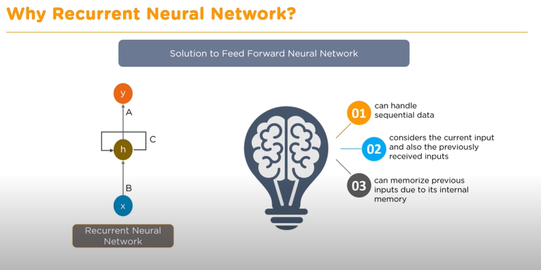

Slide 11
RNN has hidden state which remembers the information.
Thus,RNN has a memory.
It uses the same parameters for each input as it performs the same task on all the inputs or hidden layers to produce the output.
Recurrent Neural Network(RNN) are a type of Neural Network where the output from previous step are fed as input to the current step.

Slide 12


Slide 13
Now there is a problem with RNN too; They learn through back propagation over time.
This could lead to vanishing gradient problem if we ask them to learn from long term dependencies.
In simple words they can not remember important information that may require in a later time stamp.

Slide 14
To overcome these problems we use LSTM (long short term memory) is used.
Long Short-Term Memory (LSTM) networks are a type of recurrent neural network capable of learning order dependence in sequence prediction problems and learns to use relevant information to make predictions.
Ex: The color of the sky is _____
I spent 20 long years working for underprivileged kids in Spain. then moved to Africa.
I speak fluent _______.???
An LSTM unit mainly consists of a cell state (can carry relevant information throughout the processing of the sequence) and three Gates (read a special formation of network layers) - forget gate,input gate and output gate.

Slide 15
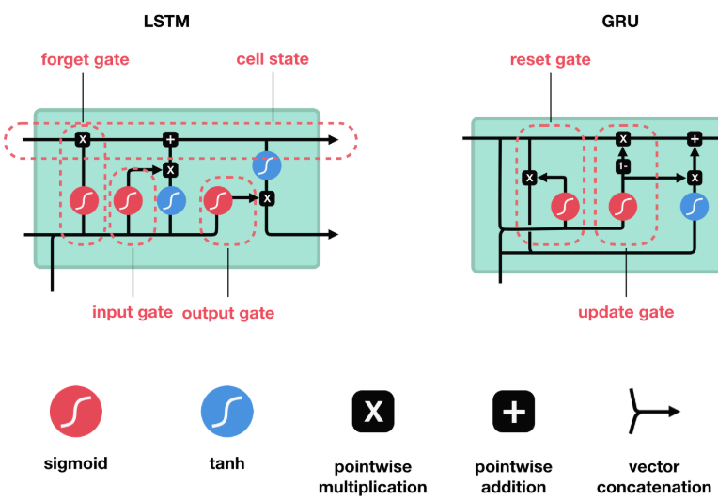
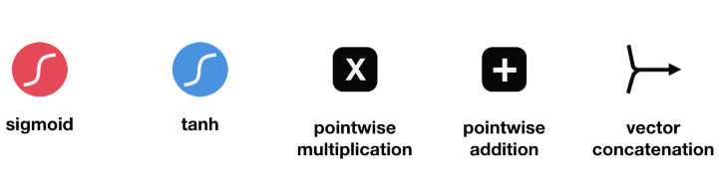

Slide 16
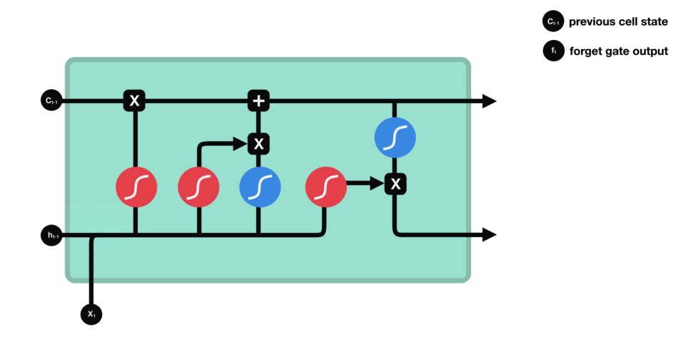
Gates contains sigmoid activations. A sigmoid activation is similar to the tanh activation. It squishes values between 0 and 1.
Forget Gate
This gate decides what information should be thrown away or kept.
Information from the previous hidden state and information from the current input is passed through the sigmoid function.
Values come out between 0 and 1. The closer to 0 means to forget, and the closer to 1 means to keep.

Slide 17
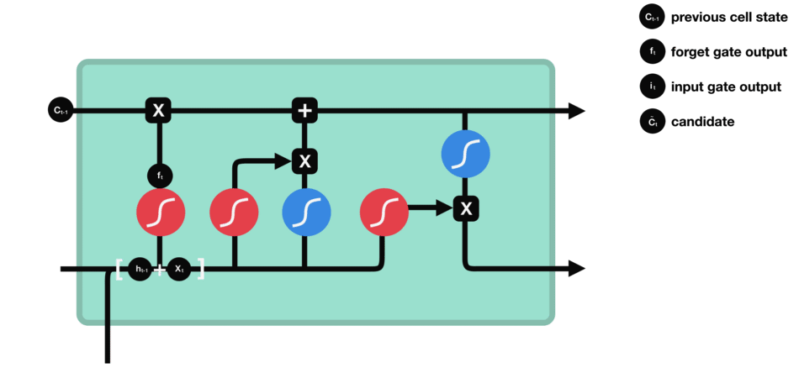
Input Gate
To update the cell state, we have the input gate.
First, we pass the previous hidden state and current input into a sigmoid function. That decides which values will be updated by transforming the values to be between 0 and 1.
0 means not important, and 1 means important.
Then multiply the sigmoid output with Tanh output, sigmoid output decides which information to keep from the tanh output.

Slide 18
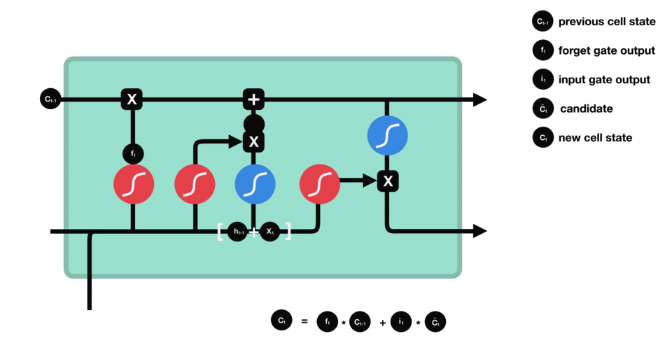
Cell State
Now we should have enough information to calculate the cell state.
First, the cell state gets pointwise multiplied by the forget vector.

Slide 19

Output Gate
The output gate decides what the next hidden state should be.
First, we pass the previous hidden state and the current input into a sigmoid function, then to the tanh function.
We multiply the tanh output with the sigmoid output to decide what information the hidden state should carry.
The output is the hidden state.
The new cell state and the new hidden is then carried over to the next time step.

Slide 20
Sequence to Sequence Model

Slide 21
Sequence to Sequence model consists of 3 parts:
Encoder
Encoder vector
Decoder

Slide 22
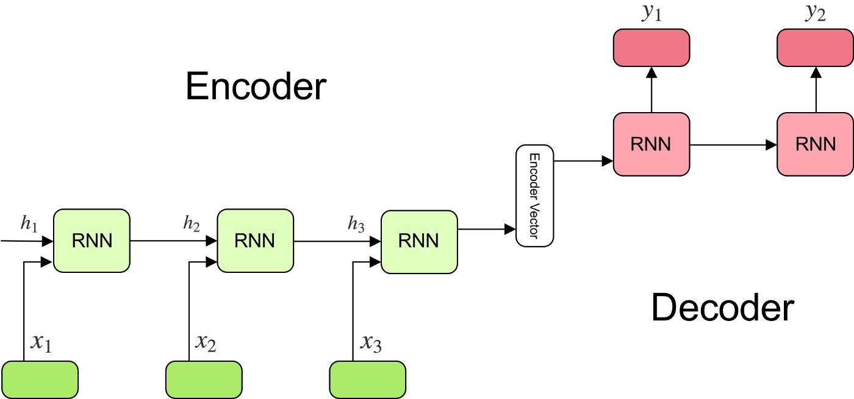

Slide 23

Encoder
A stack of several recurrent units (LSTM cells for better performance)
Each unit accepts a single element of the input sequence, collects information for that element and propagates it forward.
Input sequence-Collection of articles/article
Formula for computing hidden states:-

Slide 24
Encoder vector
Final hidden state produced from the encoder part of the model.
It is calculated using the formula above.
Encapsulates the information for all input elements in order to help the decoder make accurate predictions.
This vector aims to encapsulate the information for all input elements in order to help the decoder make accurate predictions.

Slide 25

Decoder
A stack of several recurrent units where each predicts an output y_t at a time step t.
Each recurrent unit accepts a hidden state from the previous unit and produces and output as well as its own hidden state.
Output sequence- collection of summaries/summary
Formula for computing hidden state h_i:

Slide 26

Output y_t at time-step t calculated using formula:-

Slide 27
Attention mechanism - Bahdanau attention

Slide 28
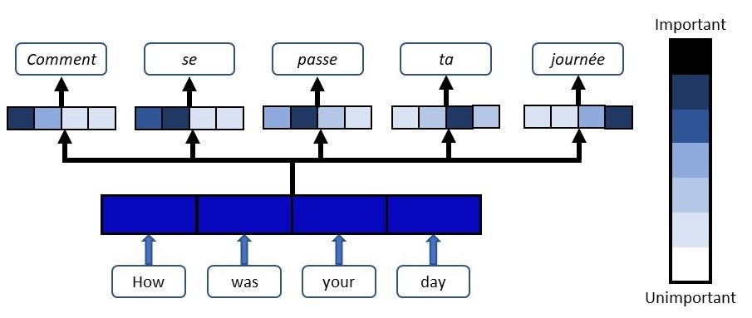

Slide 29
Attention serves to assist the encoder-decoder model in specifically focusing on certain, relevant sections when predicting the next output token.
This helps to mitigate the issue of lost context from earlier chunks of an input sequence.
Normally, only the last encoder hidden state is used.
With Bahdanau attention (which has been used ), the context vector is constructed using ALL hidden states of the encoder.

Slide 30

Step 0: Prepare hidden states.

Slide 31
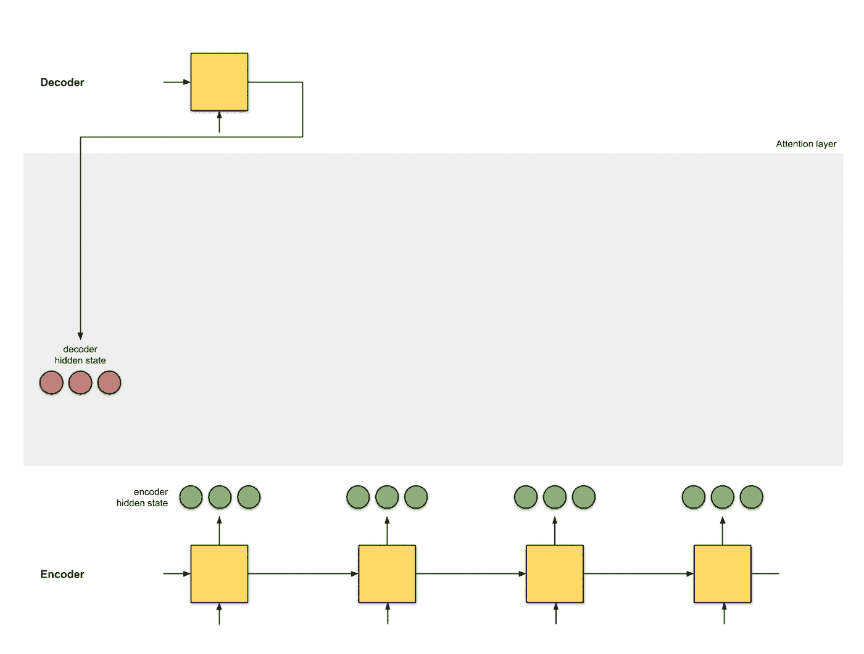
Step 1: Obtain attention scores

Slide 32
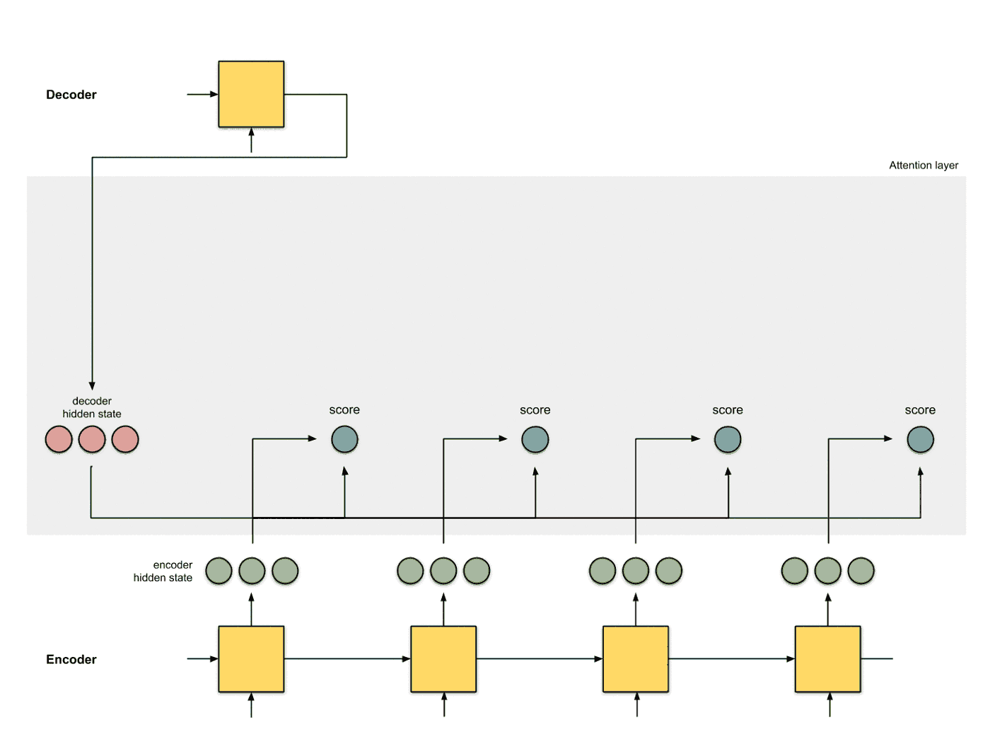
Step 2: Run scores through softmax layer

Slide 33

Step 3: Multiply encoder hidden state with softmaxed score

Slide 34
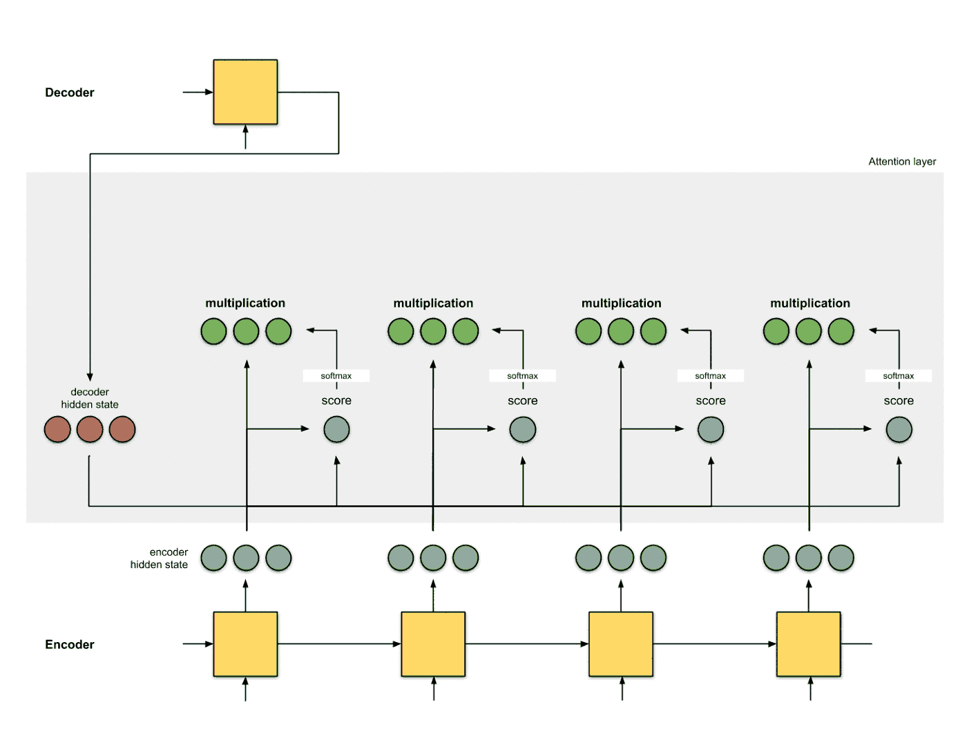
Step 4: Sum up alignment vectors

Slide 35
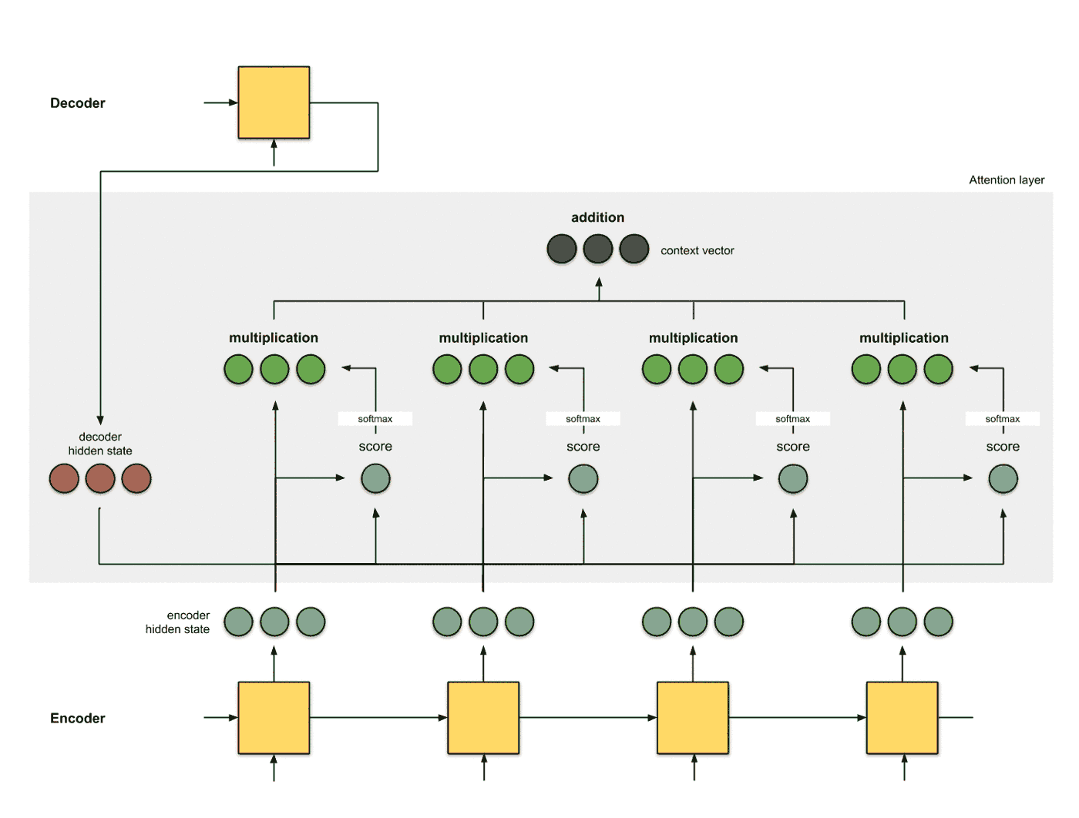
Step 5: Feed the context vector into the decoder

Slide 36
Tools Used

Slide 37
Tool | Description
Dataset | Harvard NLP/sent-summary which consists of news articles with summaries
Python | Programming Language Used
Tensorflow | An end-to-end open source machine learning platform for everyone,artificial intelligence library, using data flow graphs to build models like neural networks
Keras | Deep-learning library
NLTK | Natural language Toolkit for preprocessing of data
Gensim module | It is a Python library for topic modelling, document indexing and similarity retrieval with large corpora.
Glove | Used for obtaining vector representations for words.

Slide 38
Word Embedding

Slide 39
Word Embedding
Words or phrases from the vocabulary are mapped to vectors of real numbers.
Some popular tools used for word embedding:-
Glove
Word2Vec
Gensim

Slide 40
Preprocessing

Slide 41
Preprocessing steps performed
Tokenization: Process of tokenizing or splitting a string, text into a list of tokens. Some characters like punctuation marks are discarded.
<unk> tag added when a word in unknown and is not present in training dataset
Adding of # in case of numbers because model learning numbers doesn’t make much sense
Padding to make sentences of same length
Inserting start and end tokens

Slide 42
Use case Diagram

Slide 43
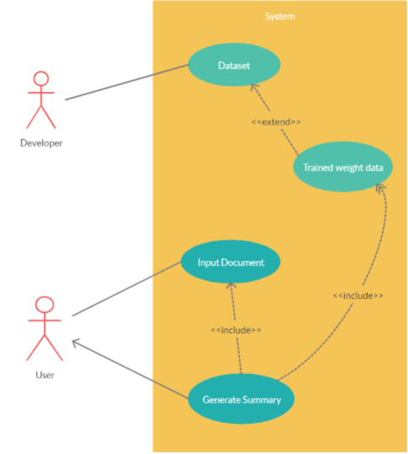

Slide 44
Workflow Diagram

Slide 45
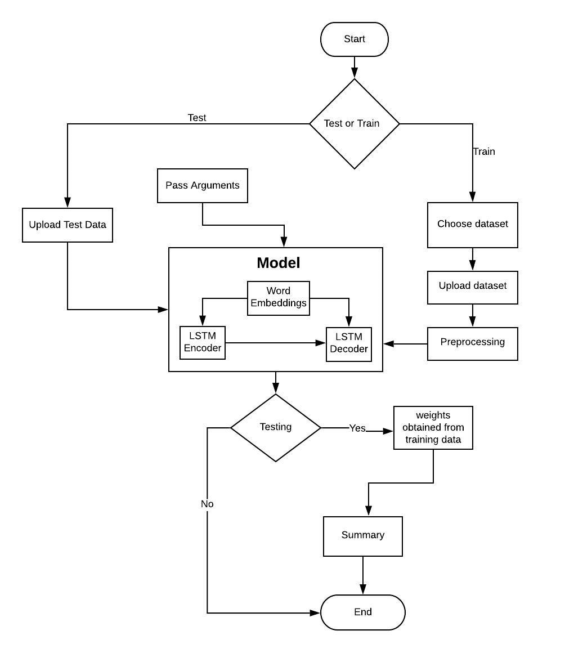

Slide 46
Results

Slide 47
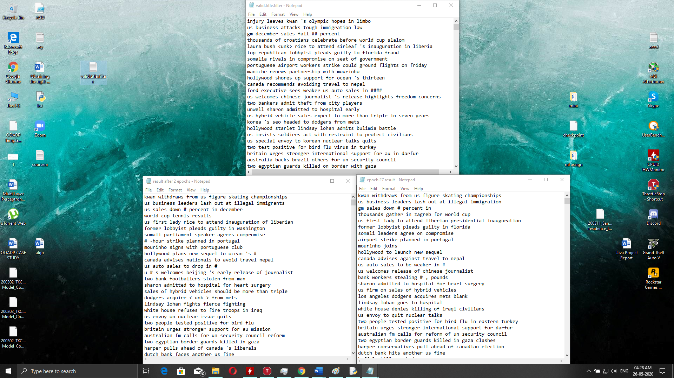

Slide 48
Advantages
Decent Rouge and BLEU scores
Captures the main idea of the article pretty well.
Generates grammatically correct summaries.
Summaries are coherent
Good for generating short summaries linke newspaper headlines

Slide 49
Limitations
Summaries generated for large articles are not very good due to lack of co-reference resolution.
Can’t generate perfect summaries when out of vocabulary words are given.
Doesn’t generate numbers in summary

Slide 50
Future Scope and Improvements that could be made
Larger datasets for training
Can increase the number of training epochs
Can make the model work for large articles
Pronoun/reference resolution not good for larger articles
Larger vocabulary can be used so that <unk> tag doesn’t appear

Slide 51
Pseudo Code

Slide 52
Training
import necessary libraries FUNCTION add arguments(parser) Add necessary arguments that can be overridden ENDFUNCTION open file args.pickle dump argument values to pickle file IF path saved_model does not exist then create directory ELSE Set path to previously saved model ENDIF Print "Build Dictionary" CALL build_dict() Print "Loading train dataset" CALL build_dataset() WITH tensorflow session as sess CALL Model() INITIALISE tensorflow session variable IF old_ckpt in global variables Print "Continuing from previous trained model" restore previously saved model print "Iteration starts" print "Number of batches per epoch" FOR batch x and y in batches: CALCULATE batch decoder variables run tensorflow session Print "Loss value" Print "Epoch No" Print "Elapsed Time" ENDLOOP ENDWITH

Slide 53
Utilities
import necessary libraries SET path for training and validation FUNCTION clean_str(sentence) Pre-processing a sentence RETURN sentence END FUNCTION FUNCTION text_list(file_path,toy) WITH file open as f IF not toy RETURN CALL clean_str() ELSE RETURN CALL clean_str() for 50000 lines ENDIF ENDWITH END FUNCTION FUNCTION build_dict(step,toy as FALSE) IF step is "train" Clean sentences for the data in data path FOR clean sentence Append tokenization ENDLOOP Enter dictionary for unknown values WITH file open as word_dict.pickle Enter dictionary to pickle file ENDWITH ELIF step is "valid" Load dictionary from pickle ENDIF END FUNCTION
FUNCTION build_dataset() IF step is "train" GET train data given in the data path ELIF step Is "valid" GET test data given in the data path ENDIF Tokenize the data END FUNCTION FUNCTION batch_iter() Pass inputs into array FOR epoch in range of num_epochs GET inputs and outputs ENDLOOP FUNCTION get_init_embedding() GET word2vec and glove word embeddings Print "Loading Glove vectors" FOR word in reversed_dict.items() Try word_vectors is in word_vec(word) ENDtry ENDLOOP
ENDFUNCTION Assigning vectors to tokens RETURN numpy array with word_vec_list END FUNCTION

Slide 54
Model
import necessary libraries CLASS Model FUNCTION __init__() INITIALISE variables Assign cell to BasicLSTMCell INITIALISE decoder length,input,target,step,batch_size WITH tf.name_scope "embedding" EXECUTE EMBEDDING FUNCTIONS INITIALIZE encoder and decoder embedding inputs ENDWITH WITH tf.name_scope "encoder" EXECUTE LSTM ENCODER FUNCTIONS WITH tf.name_scope ”decoder" EXECUTE LSTM DECODER FUNCTIONS
COMPUTE Sequence length and output ENDWITH WITH tf.name_scope "loss" EXECUTE LOSS FUNCTIONS COMPUTE gradient and loss values ENDWITH ENDFUNCTION

Slide 55
Testing
import necessary libraries WITH file open as args.pickle LOAD pickle file to pass arguments ENDWITH Print "Loading dictionary..." CALL Build_dict("valid",args.toy) print("Loading validation dataset...") CALL build_dataset() WITH tensorflow as sess Print "Loading saved model..." CALL Model() GET tensorflow global variables LOAD saved model checkpoint and restore Print "Writing summaries to 'result.txt'..." FOR batch in batches: CALCULATE batch_len INITIALISE valid_feed_dict for batch variables RUN prediction model with dictionary SAVE Prediction_output WITH file open as result.txt FOR line in prediction Print word in summary ENDLOOP Print summary line by line within file print('Summaries are saved to "result.txt"...') ENDWITH print('Summaries are saved to "result.txt"...') ENDWITH

Slide 56

Thank You!
Any questions?

